Slide 1


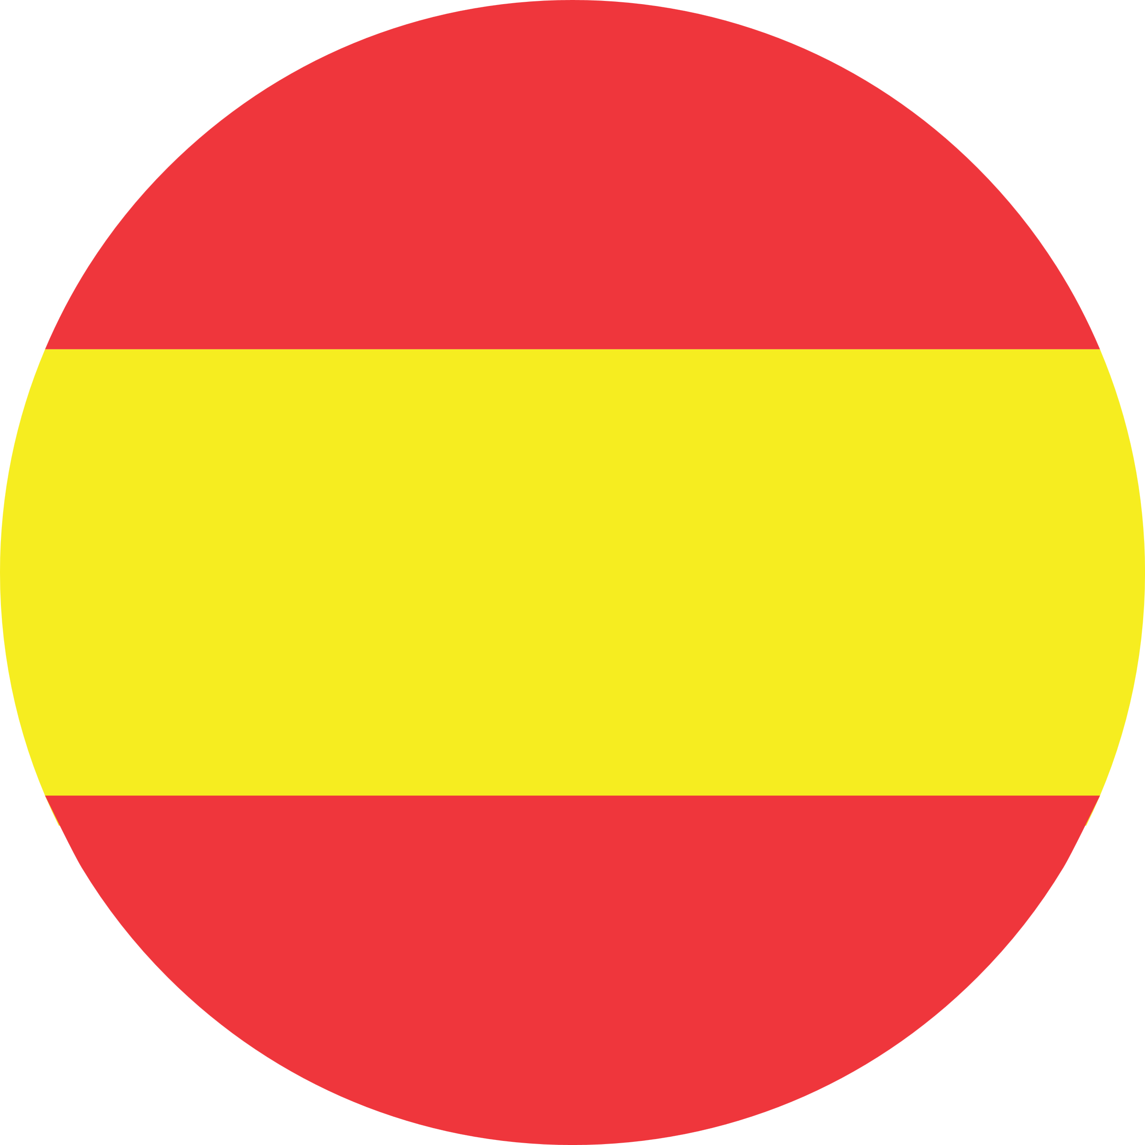

Year 4 Spring 1 Knowledge Organiser: Alien faces & family
Noun Bank: Family
el papá -the dad
el hermano – the brother
el bebé – the baby
el abuelo – the grandad
la mamá - the mum
la hermana – the sister
la abuela- the grandma
Soy… - I am ….
Noun Bank: Face parts
la nariz – the nose
la boca - the mouth
la cabeza - the head
el pelo - the hair
los ojos – the eyes
las orejas - the ears
Tengo… – I have …
No tengo… - I don’t have any…
Phonics
“za” (cabeza)
“ja” (oreja)
“jo” (ojo)
Grammar
There are also two words for “the” with Spanish plural nouns: “los” and “las”.
Grammar
There are two words for “the” in Spanish with singular nouns.
These words are “el” and “la”.
Fact
In Spain, some children call their grandparents “abu”.
If the baby is a boy, you say “el bebé”, and if the baby is a girl, you say “la bebé”.

